Slide 1

(Summer & Fall 2024 update)
DASHBOARDS for Affordable and social Housing
V2
Lakshika Paiva
Master of Digital Transformation and Innovation

Slide 2

AGENDA
Key Objective
Requirements Analysis
Design & Development
DASH demonstration
Challenges
Lessons Learnt

Slide 3
KEY Objective
Analyze Case 1 interviews and release a new iteration of the DASH prototype

Slide 4
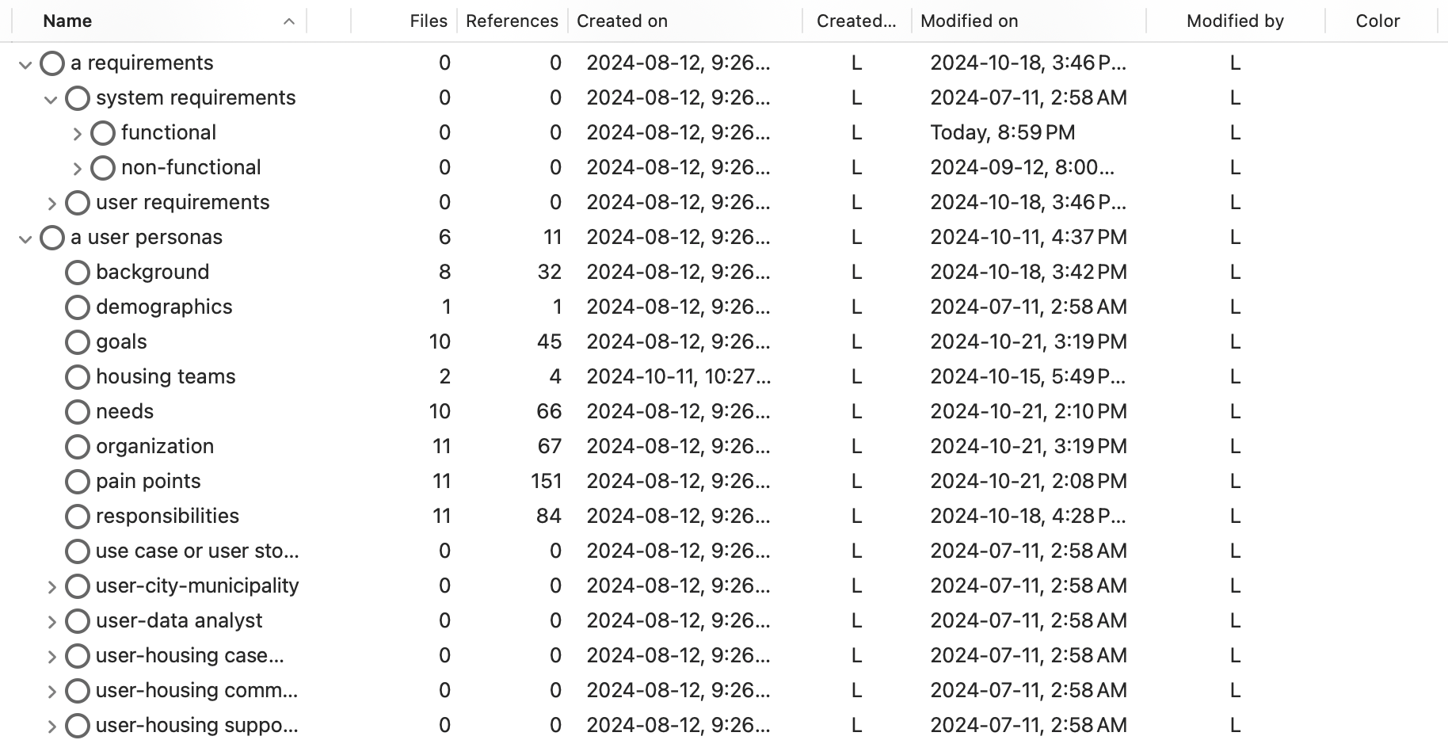
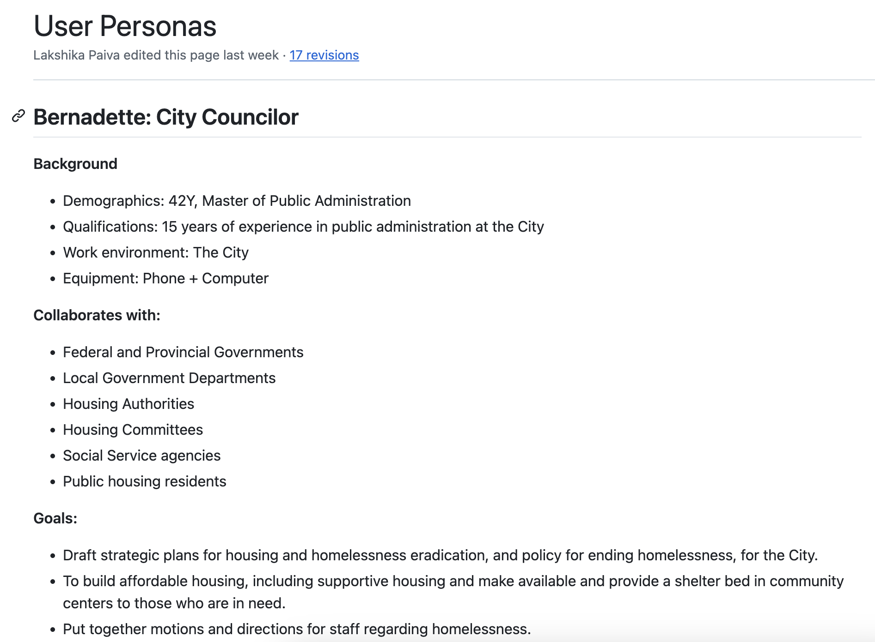
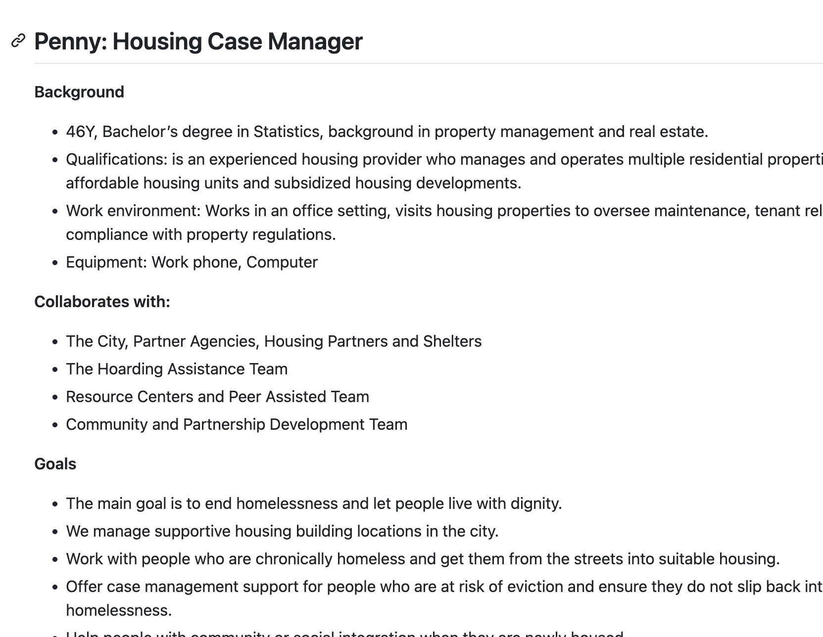
REquirements analysis
Case 1 (Ottawa) interviews were analyzed – using NVivo
Qualitative coding process – Analysis Framework
Extracted 3 recurring user personas:
Bernadette, the City Councilor (1)
Penny, the Housing Case Manager (4)
Raj, the Data Analyst (2)
Extracted users' goals, needs, pain points and responsibilities
Extracted Solution Requirements
Functional and Non-Functional Requirements
https://github.com/UOttawa-Social-Housing-Dash/DASH-Proto/wiki/User-Personas
https://github.com/UOttawa-Social-Housing-Dash/DASH-Proto/wiki/User-Stories
https://github.com/UOttawa-Social-Housing-Dash/DASH-Proto/wiki/Solution-Requirements

Slide 5
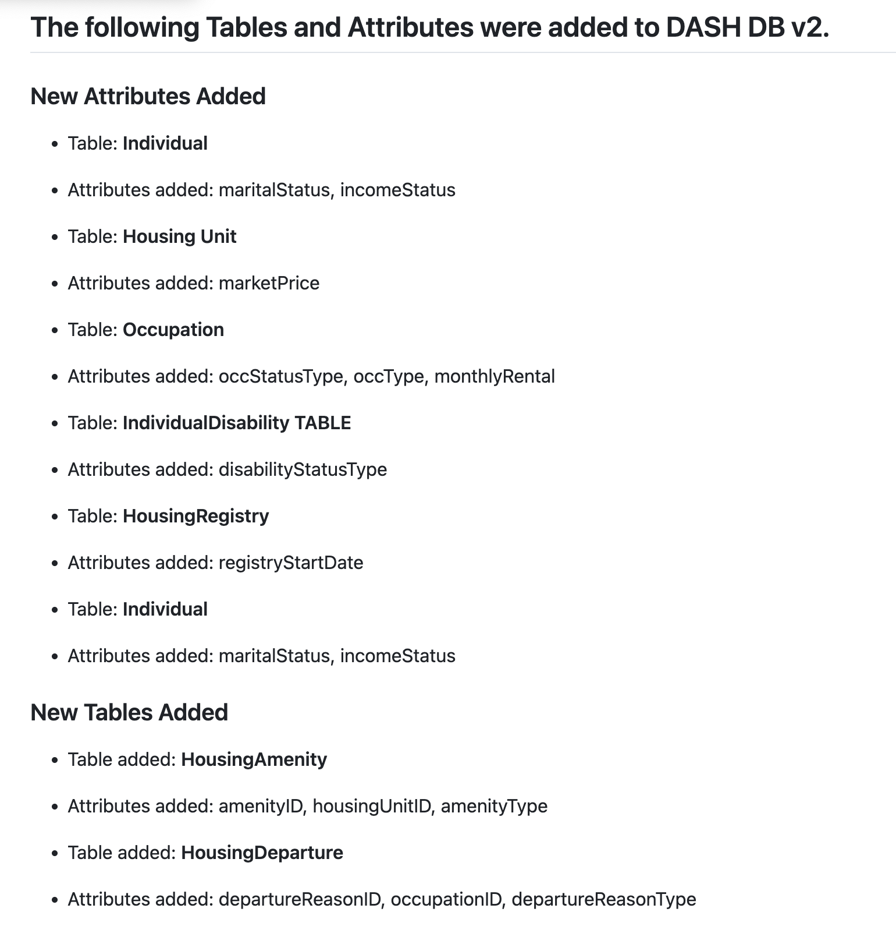
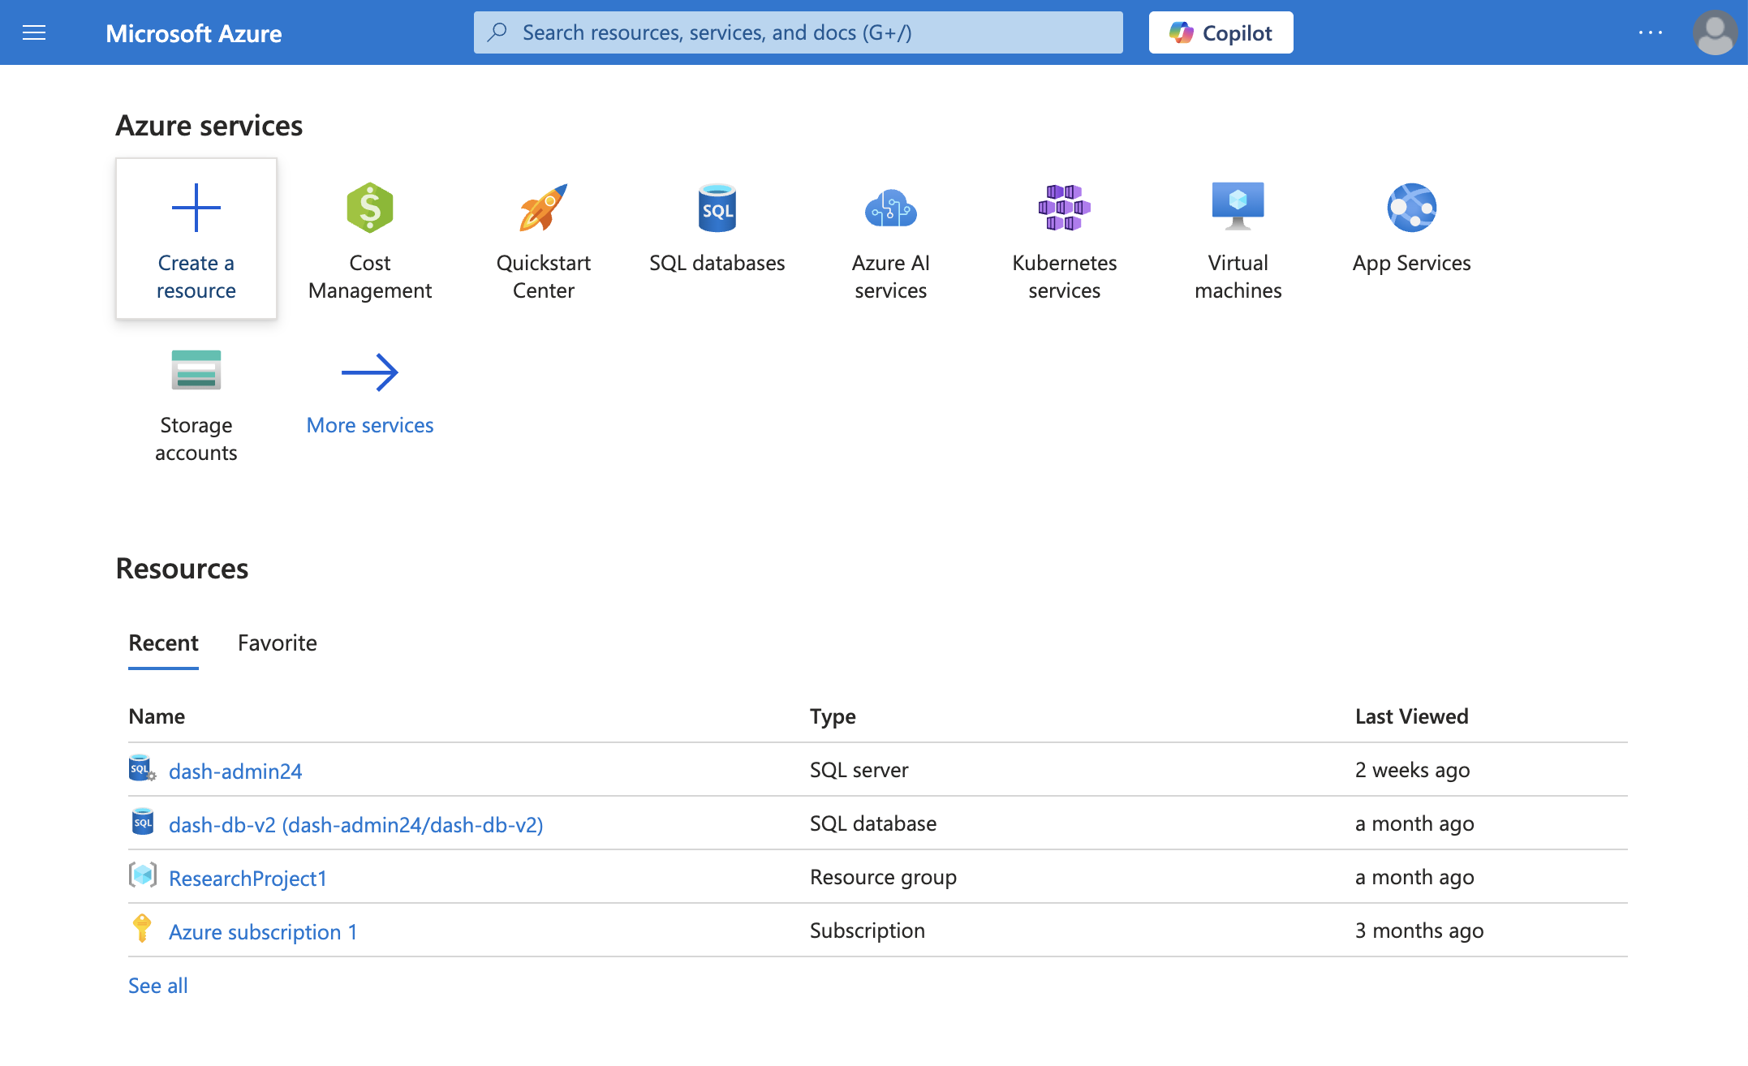
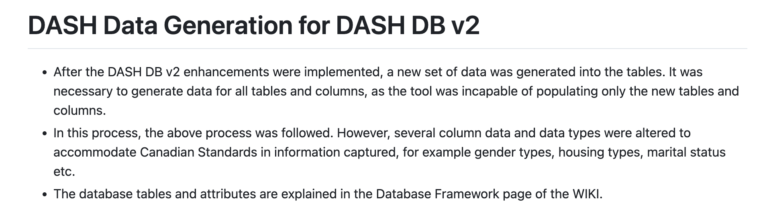
Design & Development
Migrated the existing database to a new SQL Server in a new Azure account, dedicated to DASH.
Enhanced the existing database to add 2 new tables and new columns
Tables: HousingAmenity Table, HousingDeparture Table
Columns: Individual, HousingUnit, Occupation, IndividualDisability, HousingRegistry
Generated data into new tables and columns using DBForge Data Generator.
Links - https://github.com/UOttawa-Social-Housing-Dash/DASH-Proto/wiki/Database | https://github.com/UOttawa-Social-Housing-Dash/DASH-Proto/wiki/Data-Framework

Slide 6

Implementation
DASHBOARD DEMONSTRATION

Slide 7
Challenges
Evolving scope of the project
Technical challenges in NVivo Tool:
Data deletions, inconsistent updates to the cloud, inconsistent performance of the tool, no query results etc.
Tools limited to Windows environments (PowerBI, SSMS, DBForge)
Lack of knowledge in new tools and time taken to transfer knowledge/ self-learn
Notes:
Lack of decision makers in interviews to extract requirements
Some requirements are out of scope – programs/ services etc?
Orgs do not collect all the data that users want to see in graphs – disability and health information
Concerns about if and why they should collect information – vulnerable groups / eviction reasons etc
A number of assumptions when elaborating requirements – such as data stored in each variable/ using standards might be different to actual/ diff orgs have diff information

